Slide 1
Sales Analysis
File created on: 2/22/2020 9:40:36 PM

Slide 2
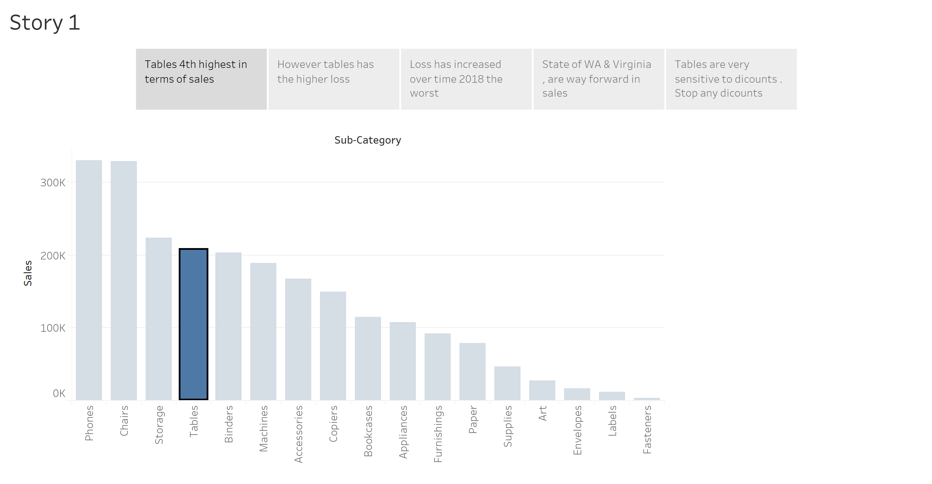

Slide 3
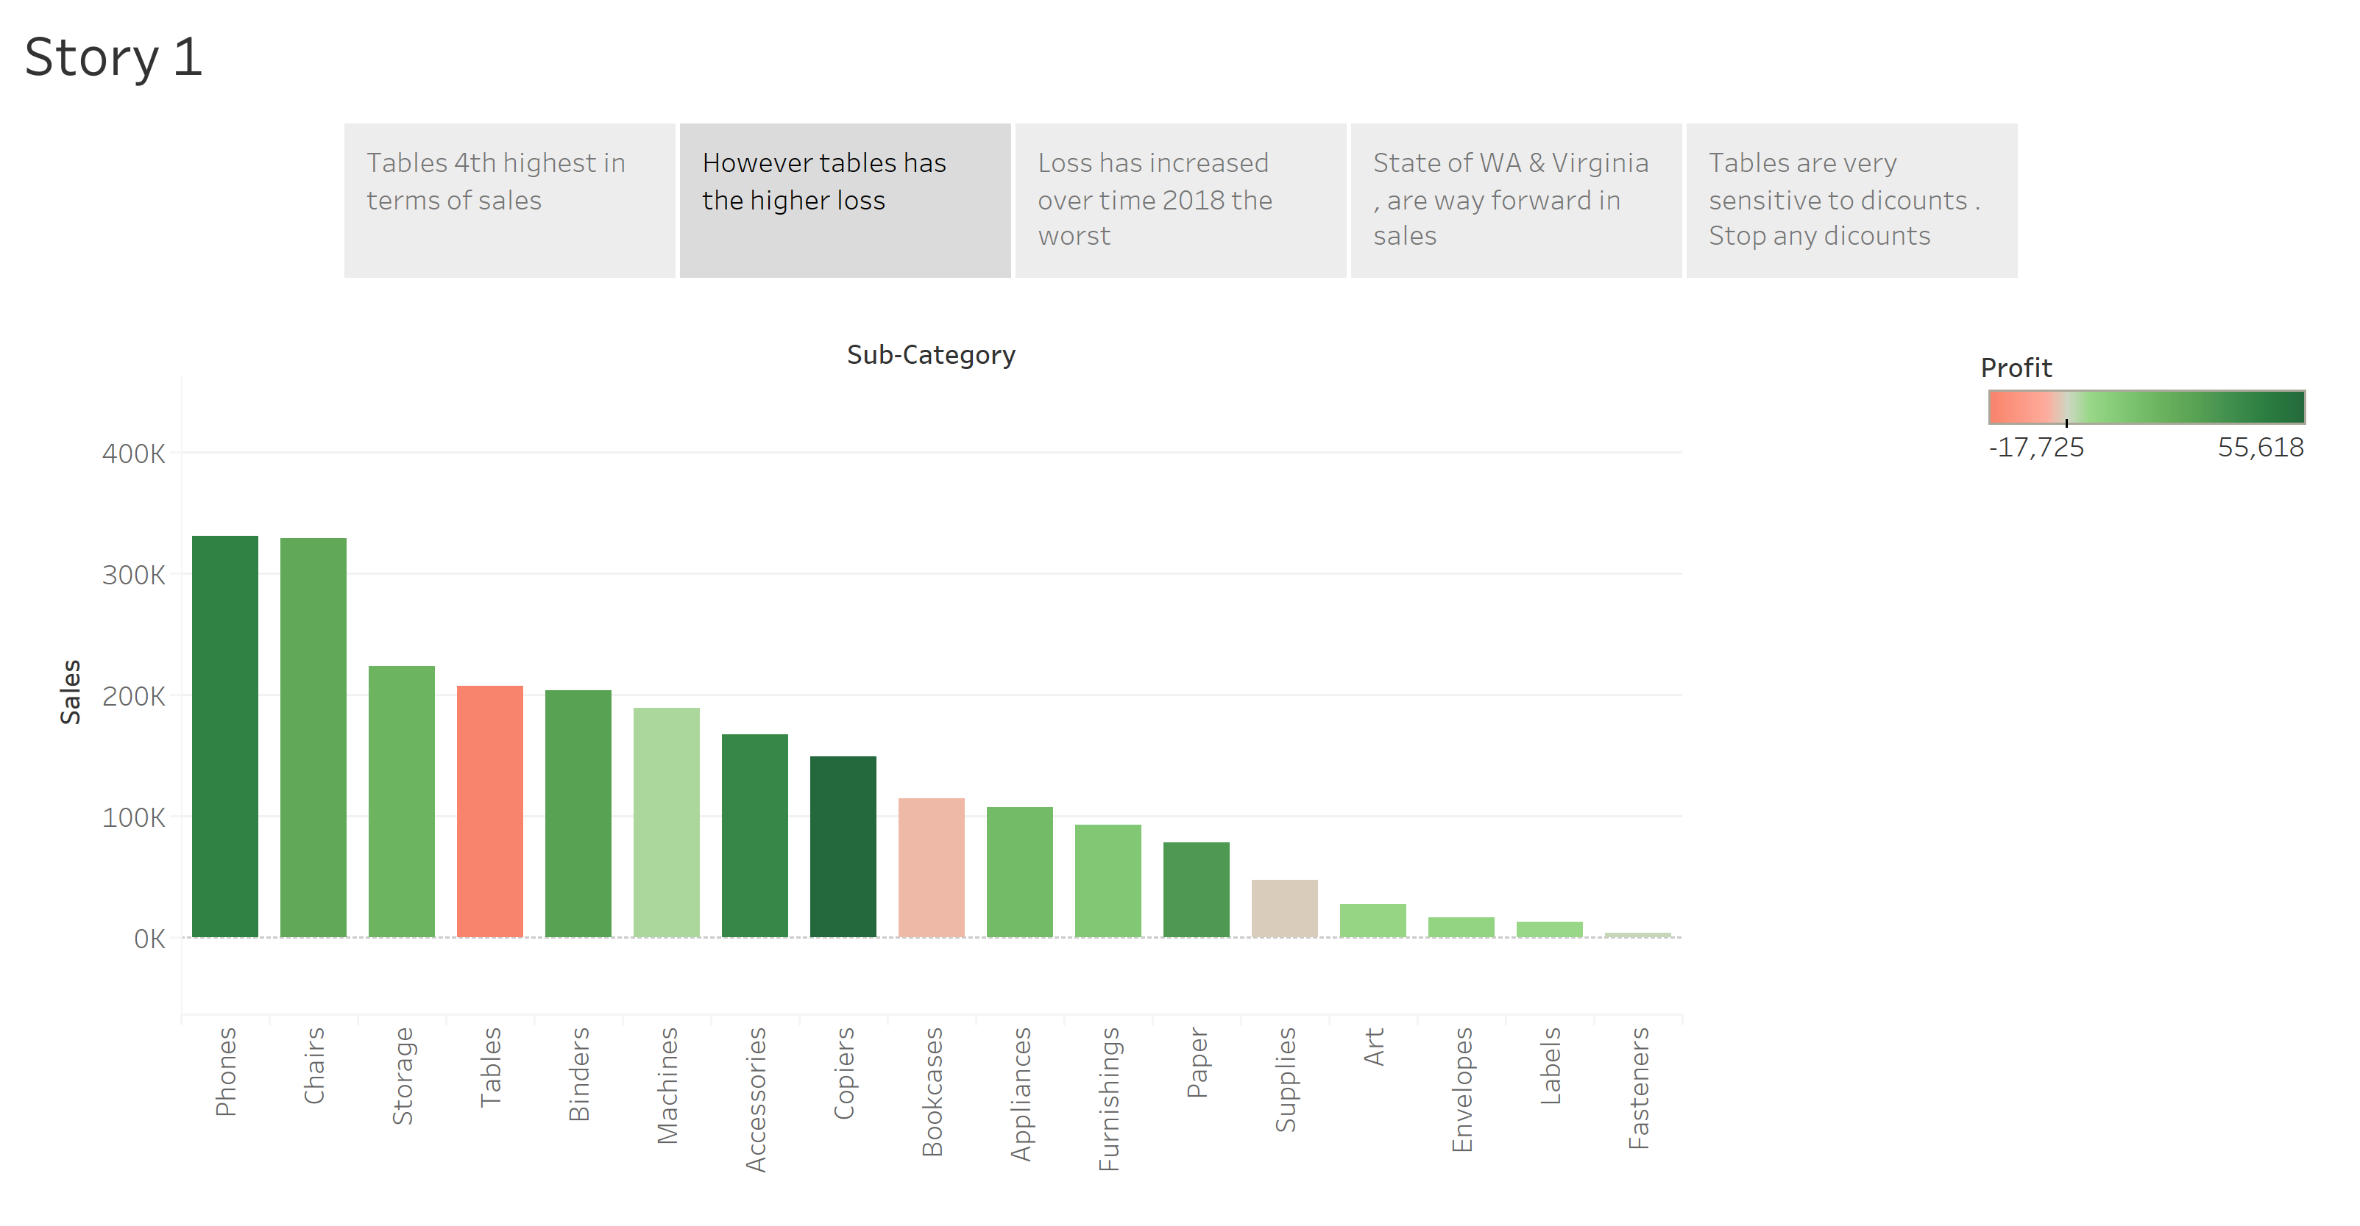

Slide 4
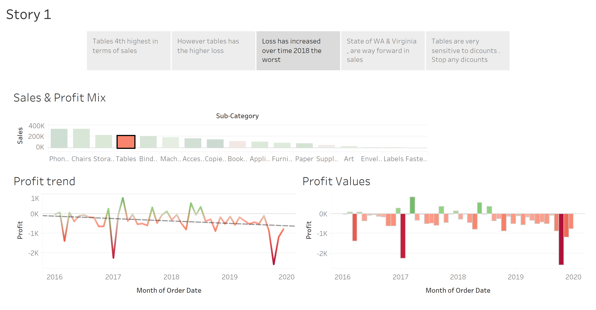

Slide 5
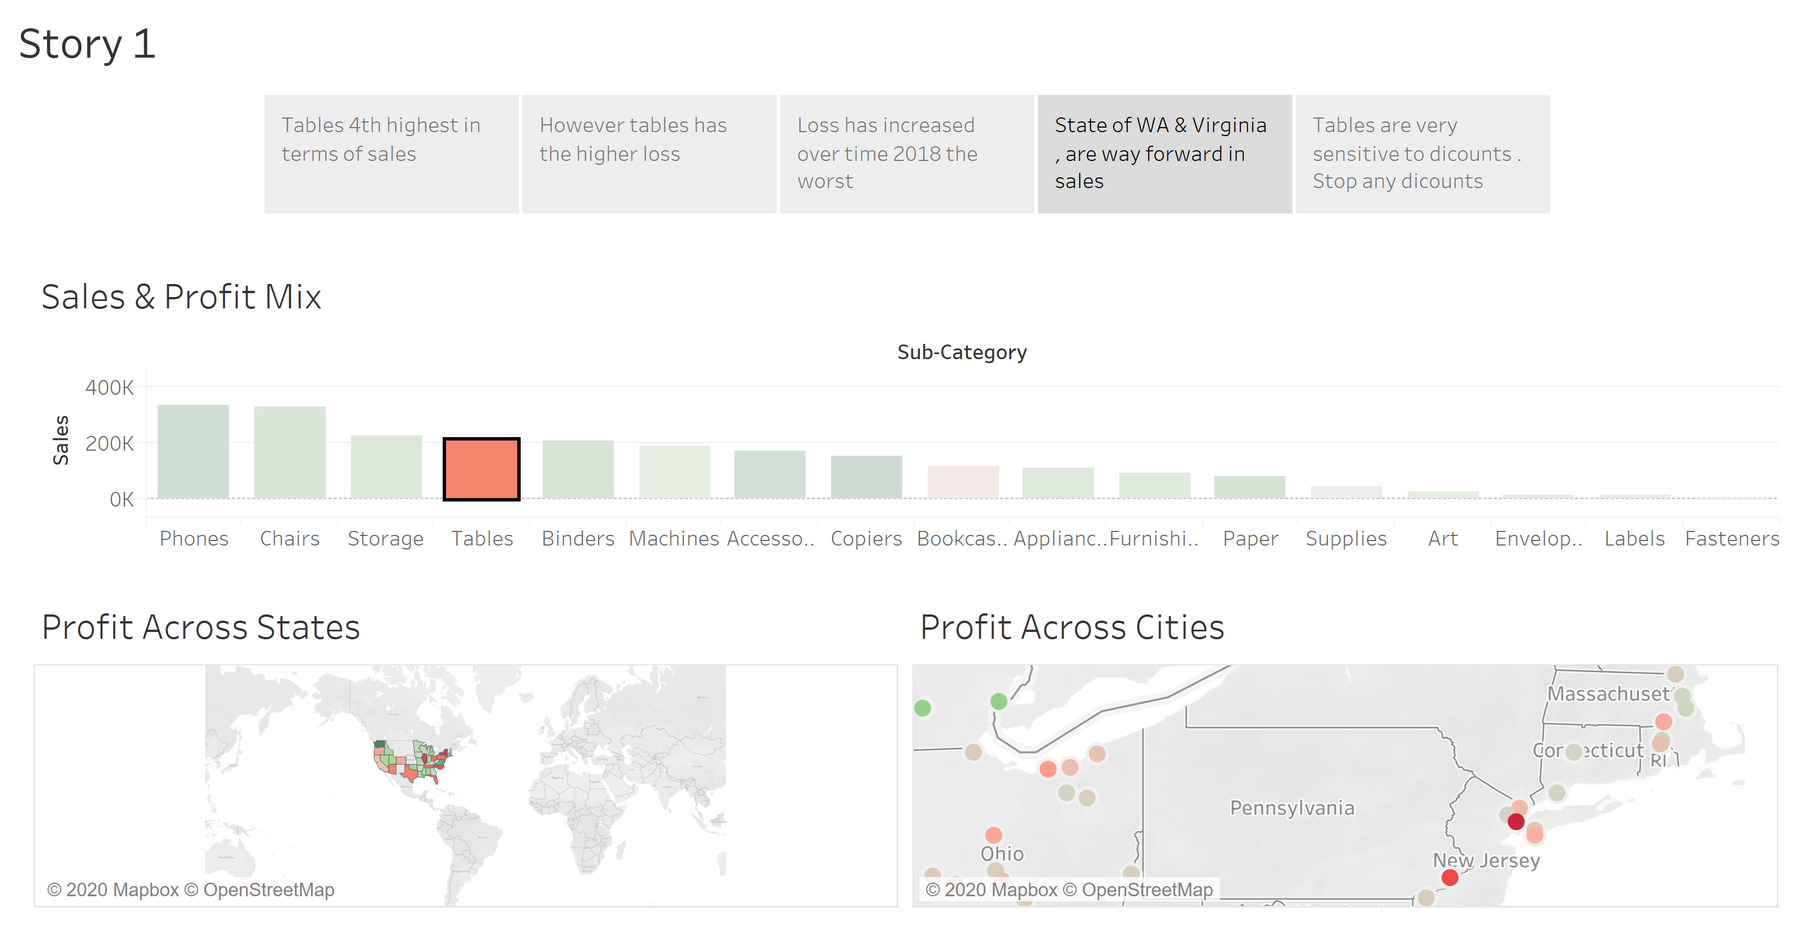

Slide 6
